Slide 1
Presented by:-
Damor Hemangini
Vilas
Pinal

Slide 2
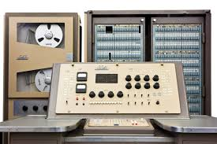
What is Mainframe Computers
Large organization use mainframe for highly critical application such as bulk data processing,meteorological surveys and ERP.

Slide 3
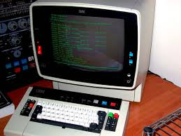
•Most of the mainframecomputers have the capacities to host multiple operating system and operate as a number of virtule machines and thus substitute for several small servers.

Slide 4
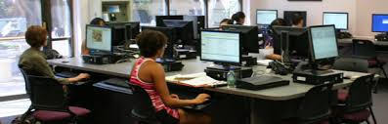
They are for computers which are used for desktop funtion of over one hundred people simultaneously.

Slide 5
Thank You

